Slide 1
Week 5
Joining the pieces

Slide 2
Recap
What we’ve built so far
ALU
RAM chips
Elementary logic chips (And, Mux16, etc)
We know machine language inside and out

Slide 3
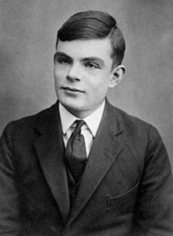
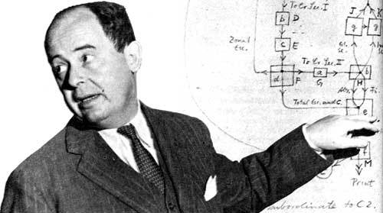
How do we execute ANY command?
Theory
Universal Turing Machine
Practice
Von Neumann Architecture

Slide 4
Universal Turing Machine

Slide 5
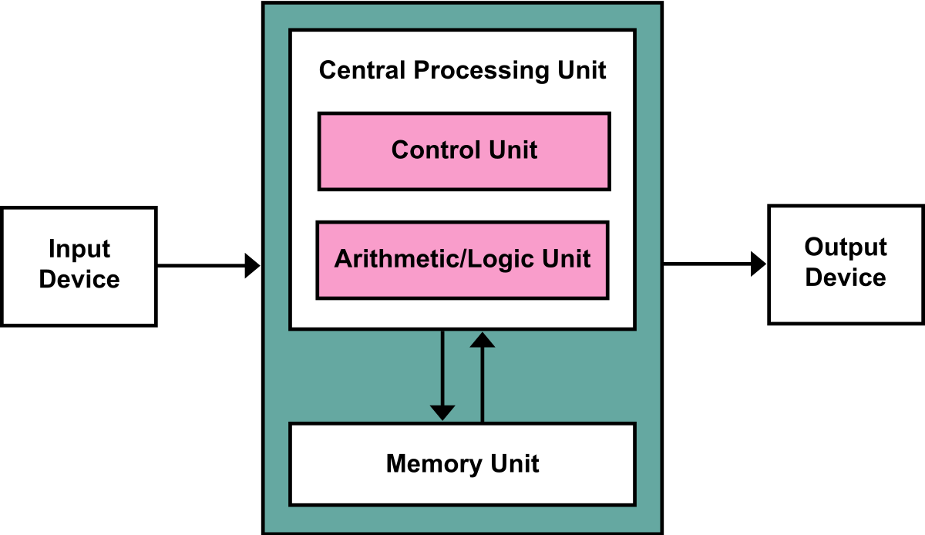
Von Neumann Architecture

Slide 6
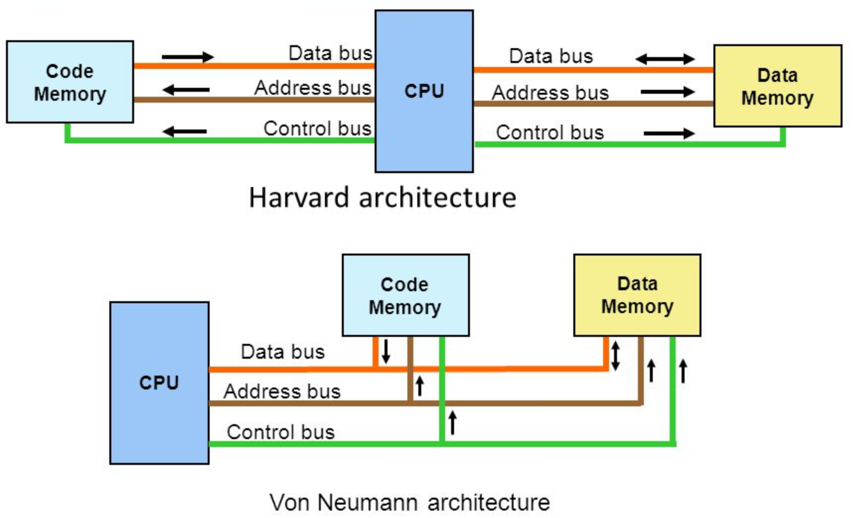

Slide 7
Von Neumann vs Harvard Architecture
Von Neumann
Same memory holds data & instructions
Single set of address/data buses between CPU and memory
Harvard
Separate memories for data (RAM) and instructions (ROM)
Two sets of address/data buses between CPU and memory
Allows for two simultaneous data fetches

Slide 8
Von Neumann vs Harvard Architecture
Harvard
Greater memory bandwidth
More predictable bandwidth

Slide 9
RISC vs CISC
Reduced Instruction Set Computer (RISC)
Compact, uniform instructions facilitate pipelining
More lines of code = large memory footprint
Allow effective compiler optimization
Complex Instruction Set Computer (CISC)
Many addressing modes and long instructions
High code density
Often require manual optimization of assembly code for embedded systems

Slide 10
Adding two numbers
The RISC approach
The CISC approach
@0
D=M
@1
D=D+M
@2
M=D
ADD @0, @1

Slide 11
RISC vs CISC
RISC
CISC
Emphasis on software
Single-clock
Large code size,
Lower cycles per second
Independently LOAD and STORE
Emphasis on hardware
Multi-clock instructions
Small code size
More cycles per second
LOAD and STORE incorporated in different functions

Slide 12
The advantage of RISC
Similar execution time
Separate LOAD and STORE functions actually lessen load
More room for general purpose registers
Uniform execution time allows for pipelining

Slide 13
Example
RISC | ARM7 | ARM9
CISC | Pentium | SHARC DSP
 | Von Neumann | Harvard

Slide 14
General computer vs dedicated computer
Which of the below is a general computer?
Apple iPhone
HDTV
PC
Industrial control unit

